Slide 1
Unit 2 (Introduction to Forensic Science and Cyber Law)
Ms. Ashna Bhatia
Research Scholar, NFSU Gandhinagar

Slide 2
Contemporary Development in Academics and Practices in Forensic Sciences
🞄
The first Central Fingerprint Bureau (CFPB) of India was established in Kolkata in
India in the year 1897 and became functional in 1904.
🞄 Ever since then, the usage of forensic science in crime investigation has routinely started in India and since then efforts are being made for capacity building of forensics in India.
🞄 Several State (SFSLs) and Central Forensic Science Laboratories (CFSLs) were established in India; the Fingerprint Bureau have also been established in various states.
🞄 At present, there are
36 State and Union Territory Fingerprint Bureaus and about 7
Central Forensic Science Laboratories (CFSLs) and 32 State Forensic Science
Laboratories (SFSLs) in India
. In several states,
106 Regional Forensic Science
Laboratories (RFSLs) and 552 Mobile Forensic Science Units (MFSLs)
have also
been established.
🞄 An
advanced Centre for DNA Fingerprinting and Diagnostics (CDFD) has been
established in Hyderabad
under the
Department of Biotechnology, Ministry of
Science and Technology, Government of India
.
🞄 The Center for Cellular and Molecular Biology (CCMB) Hyderabad, CFSL
Hyderabad, and CFSL Kolkata have been the pioneering institutions to start the
facilities of DNA Profiling in criminal cases in India after the technology was introduced in London in 1985 by Professor Alec Jeffreys.

Slide 3
🞄 DNA Profiling in criminal cases such as homicide, suicide, sexual assaults, terrorist activities, wildlife forensics, and other criminal cases is now continuing in various police departments, forensic institutions, and wildlife departments for human and animal identification from the biological fluids and the tissue materials.
Contemporary Development in Academics and Practices in Forensic Sciences
🞄 There are over working in the Fingerprint Bureau,
4500 forensic personnel
Forensic Science Laboratories (FSLs), and Chemical Examiners Laboratories in
India
🞄 As per calculations, there are only
0.33 forensic scientists per 0.1 million
population in India
as far as the work of examination of criminal cases and
reports preparation is concerned

Slide 4
🞄 India has over
100 universities and colleges
including the National Forensic
Contemporary Development in Academics and Practices in Forensic Sciences
Science University at Gandhinagar, Gujarat, and Rashtriya Raksha
University at Lavad, Gandhinagar where the School of Forensic Science & Risk Management is also imparting teaching, research, and training to the students, Police and Paramilitary forces for security purposes.
🞄 The exclusive teaching and research-oriented staff in the universities and colleges are about 500.
🞄 The Ministry of Home Affairs, Government of India, intends to establish Regional Centers for academic research and training affiliated with the National Forensic Science University, Rashtriya Raksha University, and institutions of National Importance.
🞄 India has many colleges and universities that offer forensic science courses, including:
🞄 B.Sc. in Forensic Science: 119 colleges offer this course, with 98 private, 8 public, and
2 public-private.
🞄 M.Sc. in Forensic Science: More than 100 colleges offer this course, with 61 private and 34 government.
🞄 National Forensic Sciences University (NFSU): The world’s first university dedicated to forensic science, with 10 campuses, 11 schools, 14 CoE/Centres, and 83 programs.
🞄 Central Forensic Science Laboratories: Seven laboratories located in Hyderabad, Kolkata, Chandigarh, New Delhi, Guwahati, Bhopal, and Pune
🞄 Some of the top forensic science colleges in India, including Banaras Hindu University (BHU), Delhi University (DU), Aligarh Muslim University (AMU), Chandigarh University (CU), Amity University, and Panjab University.

Slide 5
Contemporary Development in Academics and Practices in Forensic Sciences
🞄 Nearly 50–60 thousand unidentified dead bodies have been reported annually in the country which were identified through DNA analysis and by other means.
🞄 The
National Crime Records Bureau (NCRB) and the State Crime Records
Bureau possess data about the crimes of missing persons and modus operandi
. The
data regarding missing persons is also contained by the police at different levels and
the data of the dead bodies is compared with the missing persons by the FSLs and the Fingerprint Bureaus for identification purposes.
🞄 The forensic knowledge is imparted to the police and public through print and digital media to act as a deterrent for potential criminals and as a measure of preventive forensics.
🞄
As per the data of May 2020, there are 64 independent post-graduate institutes of
medical education and research in India and 706 medical colleges as recognized by
the National Medical Commission
. These are the main institutes of legal medicine
having departments of Forensic Medicine in India. In addition to this, there are
district-level hospitals and subordinate health centres which conduct autopsies and medicolegal work.
🞄 The anthropological work about skeletal analysis and examination i.e. the estimation of the biological profile of the individual and facial superimposition and reconstruction is also carried out in the biological sciences divisions of Central and State Forensic Science Laboratories in India.

Slide 6
Contemporary Development in Academics and Practices in Forensic Sciences
🞄 Moreover,
the cases of the Information Technology Act and Cybercrime are
increasing every year
. Thus, India needs more scientifically trained investigators and
judges, and equipment for the investigation and adjudication of these cases. The delay
and pendency would remain inevitable without the capacity building of Forensics in India.
🞄 The government of India has formed a
National Disaster Response Force (NDRF)
under the Ministry of Home Affairs,
which is a special task force for rescue and
relief operations at mass disaster sites. Various NDRF teams work in rescue
operations and save the lives of many people after these unforeseen disasters.

Slide 7
The Indian Academy of Forensic Sciences
🞄
Indian Academy of Forensic Sciences:
Contemporary Development in Academics and Practices in Forensic Sciences
(IAFS) was established in the year 1960. This academy started a biennial scientific
journal, which assisted as an opportunity for the discussion of concepts in forensic science with other international bodies.
🞄
The teaching of Forensic Sciences in the Universities:
In the year 1967, Dr. DS
Kothari, the then Chairman of the University Grants Commission (UGC)
conventional a high-level commission to advise the Commission on the stages to be
occupied for an overview of Criminology and Forensic Sciences in university education. It was recommended that universities be fortified to announce courses in Criminology at the undergraduate courses and postgraduate courses in Criminology and Forensic Science should be ongoing only in a central self- governing institution, which would be affiliated with a university.
🞄
LNJP National Institute of Criminology & Forensic Science at New Delhi, Now
NFSU Delhi Campus:
National Forensic Science University, New Delhi (Lok Nayak
Jayaprakash Narayan National Institute of Criminology & Forensic Science) is the
campus of the National Forensic Sciences University and an Institution of National Importance under the Ministry of Home Affairs (MHA), Government of India as recognised by an act of the Parliament of India. It is one of the Central Police Organization (CPO) of the country. It specializes in teaching criminology, cybersecurity, digital forensics and forensic science and is located in New Delhi, India. The institute was established by the Government of India in 1972 within the Bureau of Police Research and Development following recommendations of the University Grants Commission (UGC).

Slide 8
🞄 National Forensic Sciences University: The National Forensic Sciences University
Contemporary Development in Academics and Practices in Forensic Sciences
(NFSU), erstwhile Gujarat Forensic Sciences University (GFSU) is the world’s first
and only University dedicated to forensic science and its allied subjects. This unique University was envisioned by the Hon’ble Prime Minister of India Shri Narendra Modi as then Hon’ble Chief Minister of Gujarat in 2008 to be an institution of higher learning of International standard and to meet the huge shortfall of experts in the different fields of forensic science across the world. It came into being on 11th February, 2009 at Gandhinagar, Gujarat with the appointment of Dr. J.M. Vyas as its first Director General. On 1st October 2020, the Government of India elevated the university into a National University and established NFSU through the National Forensic Science University Act. Simultaneously, NFSU has also been accorded the status of an Institution of National Importance (INI).

Slide 9
🞄 The evidences which are present at the crime scene are called physical evidence, the analysis of which helps in linking the criminal, and victim with each other and with the crime scene.
🞄 Forensic sciences being an important factor in the criminal justice system plays a vital role in providing scientific information through the analysis of physical evidence to the investigator.
Advantages of Scientific Investigations
🞄 It is mainly concerned with the identification of traces of evidence left at the scene, their scientific analysis in the lab, and finally reconstruction of events.
🞄 The aim of conducting criminal investigations scientifically means to recognize the evidence at the scene of the crime which can be analyzed scientifically in the forensic science laboratory and help answer the questions posed by the investigating officer and help to identify the suspected person who has committed the crime. To achieve this aim, the investigation needs to be conducted in the following two places:
Crime Scene
Laboratory

Slide 10
Advantages of Scientific Investigations
🞄
Crime scene investigation
is a process that aims at recording the crime
scene as it is first encountered and collecting all scientific, potentially relevant physical evidences to provide a solution in a particular case.
🞄 The evidentiary clue materials are received in the laboratory might be very diverse in nature, but the methods used to analyze them some times can have a great deal in common or some time may even be identical. Similarly, various types of patterns are also analyzed and interpreted primarily to provide assistance to reconstruct (sequence of steps) the crime, although the patterns may have been produced by quite different events involving quite dissimilar materials.

Slide 11
Scope
🞄 The range of forensics includes either one or all the four following major activities in analyzing and interpreting the physical evidence in forensic science laboratories:
Identification
Individualization
Reconstruction
Job Perspectives
* Reconstruction:
a final step of any criminal investigation. It refers to the
process of putting together the “pieces” of a case or situation to reach an
understanding of a sequence of past events. It can be achieved based on physical
evidence from the events.

Slide 12
Nature
🞄 The field of forensic science is based on several scientific fields, including physics, chemistry, and biology, which focus on the recognition, identification, and evaluation of physical evidence.
🞄 It has become an essential part of the judicial system, as it uses a wide spectrum of sciences to obtain information relevant to criminal and legal evidence. Forensic science can prove the existence of a crime, the perpetrator of a crime, or a connection to a crime through:
Examination of physical tests
Administration tests
Interpretation of data
Clear and concise relationships
A true testimony of a forensic scientist.
🞄 Forensic science has become an integral part of many criminal cases and sentences, with objective facts through scientific knowledge serving both the defence and the arguments of the prosecution.
🞄 The testimony of forensic scientists has become a reliable component of many civil and criminal cases, as these professionals are not worried about the outcome of the case; only with their objective testimony based solely on scientific facts.

Slide 13
🞄 During the forensic science process, the forensic team is used to process samples, tests and hopefully, to solve crimes. Measurements include test analysis, fingerprint detection or identification, drug or chemical analysis and body fluid management.
Tools and Techniques in Forensic Sciences
🞄 It is important to stress that it is the fusion of science and technology that allows forensic scientists to do much of their work. Sciences such as biology, chemistry and mathematics are combined with various technologies to process tests.
1.
DNA Profiling:
The evolution of DNA technology from the laboratory to forensic
science; the conscience applied for legal or court purposes, which involved the
scientific and juridical age of humanity from the scientific point of view, the technology of DNA testing technology developed by relative obscurity.
Admissibility of DNA in the Indian Legal System: The modification of CrPC by
the CrPC (Amendment) Act, 2005, has brought two new sections authorizing the
investigator to collect DNA samples from the body of the accused and the victim with the help of a medical practitioner.

Slide 14

Tools and Techniques in Forensic Sciences
DNA Profiling:

Slide 15
Tools and Techniques in Forensic Sciences
2. Narco Analysis Test or Truth Serum Test:
The analysis of the narco is a process by which a
subject is put to sleep or put into a semi-drowsy state using chemical injection and then
interrogated while in this state of sleep, or the process of injection of a “truth serum” drug in a patient/suspected person to induce the semi-consciousness and then interrogate the patient/suspect. This process was used to improve a witness’s memory.
Admissibility of Narco Analysis Test: The National Human Rights Commission (NHRC)
also published the guidelines in the year 2000 for the Administration of polygraph tests
relating to violations of human Rights.
It should not be administered without the consent of the accused.
The accused person voluntarily access to the test.
The consent should be recorded before a judicial magistrate.
The accused should appear with his lawyer and then the court mentioned that this test includes the “confessional” statement to the magistrate.
The magistrate shall consider all factors relating to the detention including the length of detention and the nature of interrogation.
The recording of this is done by the private agency in the presence of the accused lawyer.
All the narrative statements during the test relating to an offence must be taken on record and submitted to a court.

Slide 16
Tools and Techniques in Forensic Sciences
3. Polygraph or Lie Detector Test:
A polygraph test or the lie detector test is an
instrumental measurement that records the physiological responses relating to the
blood pressure, pulse, respiration, and skin conductivity which the subject is asked to answer a series of questions for the theory of false answer. The theory behind the polygraph test is that a culprit is righteously caught while getting the results from the measurement of the hyperarousal state.
4. Fingerprints:
Forensic scientists have used fingerprints in criminal investigations as
a means of identification for centuries. Fingerprint identification is one of the most
important criminal investigation tools due to two features: its persistence and its
uniqueness.
TYPES of FINGERPRINTS: Latent Prints (Invisible Prints), Patent Prints (Visible Prints), Plastic Prints (3D Prints).
🞄 Fingerprints are not the only incriminating patterns that a criminal may leave behind.
🞄 Lip prints are frequently found on glasses.
🞄 Footprints and the soil left on the print may match those found in a search of an accused person’s premises.

Slide 17
Tools and Techniques in Forensic Sciences
🞄 Tire tracks, bite marks, toe prints, and prints left by bare feet may also provide useful evidence.
🞄 In cases where the identity of a victim is difficult because of tissue decomposition or death caused by explosions or extremely forceful collisions, a victim’s teeth may be used for comparison with the dental records of missing people.
5. Handwriting:
Handwriting is a useful test of identity experiments and observation,
having disclosed that it contains general principles and questions about the reliability
of the genuineness of handwriting.
➢
Under Section 39 of the BHARATIYA SAKSHYA ADHINIYAM, 2023 (Opinion
of Experts)
, it is only the opinion of a person especially skilled in questions relating
to the identity of handwriting, which is relevant in nature.

Slide 18
Tools and Techniques in Forensic Sciences
6. Cyber Took Kits: Cyber Security Software is a must for the Cyber Security and
Privacy of a business or individual. Cybersecurity is the method used to protect the
network, system, or applications from cyber-attacks. It is used to avoid unauthorized
data access, cyber-attacks, and identity theft.
Types Of Cyber Security Tools:
🞄 Network Security Monitoring Tools: are devices and applications that help protect networks from threats by monitoring, alerting, and validating network connections. Eg. Nagios, Wireshark, Splunk, Snort, ManageEngine OpManager, Metasploit, PRTG Network Monitor, etc.
🞄 Encryption Tools: Programs that use cryptography to protect data by making it unreadable or inaccessible without a key or password. They work by scrambling data into a secret code, or ciphertext, that can only be unlocked with a unique digital key. Eg. – AxCrypt, Micro Focus ZENworks FDE, Twofish, NordLocker, Trend Micro Endpoint Encryption, etc. Encryption tools can protect data in several ways, including:
👉Protecting data at rest: Encryption tools can protect data on computers, whether they are on-premises or remote cloud servers.
👉Protecting data in transit: Encryption tools can protect data as it is being sent between computers over the internet.
👉Creating encrypted volumes: Encryption tools can create encrypted volumes on storage media that
appear as random noise.

Slide 19
6. Cyber Took Kits: Types Of Cyber Security Tools:
🞄 Web Vulnerability Scanning Tools: Automated tools that scan web applications for security vulnerabilities. They can help organizations identify and monitor security issues in their networks, systems, and applications. Eg. – Burp Scanner, Rezonate, Bright Security, RapidFire VulScan, Amazon Inspector.
🞄 Network Defence Wireless Tools: Use hardware and software to control network access and protect a company’s computer network from threats. Eg. – Firewalls, Metasploit, Wireshark, Antivirus Software, Endpoint Protectors, Nmap, Nessus, Snort, etc.
🞄 Packet Sniffers: A tool that monitors, analyzes, and captures network traffic. It can be a piece of hardware or software that connects to a network to intercept and log data packets. Packet sniffers can be used for a variety of purposes, including:
👉Troubleshooting: Packet sniffers can help identify and fix network issues, such as outages or performance problems.
👉Security audits: Packet sniffers can be used to investigate cybersecurity incidents.
👉Eavesdropping: Packet sniffers can be misused for malicious activities like eavesdropping and data theft.
🞄 Antivirus Software: A software that helps keep a computer system healthy and free of viruses and other types of malware.
Eg. – McAfee, Kaspersky, Norton, etc.
🞄 Firewall: A network security device that monitors and controls network traffic to prevent unauthorized access to a network or computer. Firewalls are often positioned between a network and the internet to protect private networks, or intranets, from unauthorized users. Firewalls work by:
👉Monitoring traffic: Firewalls monitor incoming and outgoing network traffic.
👉Applying security rules: Firewalls use a set of security rules to determine whether to allow or block traffic.
👉Protecting networks: Firewalls protect networks from unauthorized access, harmful activities, and potential threats.
Firewalls can be implemented as hardware, software, software-as-a-service (SaaS), or in the cloud. Next-generation firewalls (NGFWs) include
additional features like deep packet inspection, intrusion detection and prevention, and malware defence.

Slide 20
6. Cyber Took Kits: Types Of Cyber Security Tools:
🞄 Managed Detection Services: Managed Detection and Response (MDR) is a cybersecurity service that uses a combination of technology and human expertise to protect organizations from cyber threats. MDR services include:
👉 24/7 monitoring: MDR services continuously monitor networks, endpoints, and cloud environments.
👉 Threat hunting: MDR services proactively hunt for threats.
👉 Incident response: MDR services respond to incidents quickly.
👉 Threat intelligence: MDR services use threat intelligence to help identify threats.
👉 Data collection and analysis: MDR services collect and analyze data.
👉 Reporting and communication: MDR services provide reporting and communication.
🞄 MDR services can help organizations limit the impact of threats without needing to hire additional staff. They can also help organizations preserve their brand reputation and build customer trust.
🞄 There are three main types of MDR providers:
Bring your technology: These providers collect security information from multiple sources, but they typically only provide alerts.
Single vendor: These providers provide MDR services for their security products.
Fully flexible: These providers combine the strengths of the other two approaches.
🞄 PKI Services: Public Key Infrastructure (PKI) services are tools that help secure data transfers and communications by using public keys for encryption:
👉 Identity verification: PKI services confirm the identity of a sender or receiver by verifying ownership of a private key.
👉 Secure connections: PKI services create secure connections for public web pages and private systems like VPNs and internal Wi-Fi.
👉 Data encryption: PKI services encrypt data in a way that both parties can decrypt, ensuring that information is only sent to and received from trusted sources.
👉 Certificate management: PKI services help manage the lifecycle of certificates.
PKI services can be deployed in different ways, including:
PKI as a Service (PKIaaS): This cloud-based model eliminates the need for an organization to set up and maintain infrastructure, which can reduce costs.
On-premises: This is another deployment model for PKI.

Slide 21
6. Cyber Took Kits: Types Of Cyber Security Tools:
🞄 Penetration Testing: Penetration testing, also known as pen testing, is a security exercise that simulates a cyberattack to find vulnerabilities in a computer system.
🞄 Penetration testing can help organizations:
👉Identify weaknesses: Find vulnerabilities in systems and applications.
👉Improve security: Help security teams improve the overall security posture of a system.
👉Comply with regulations: Support compliance with data privacy and security regulations.
👉Get expert feedback: Obtain unbiased third-party feedback on security processes.
🞄 Penetration testing is often carried out by certified ethical hackers who use the same tools and techniques as attackers. The process typically involves reconnaissance, scanning, vulnerability assessment, exploitation, and reporting.
🞄 Penetration testing can be time-consuming and costly, but it can help prevent expensive and damaging breaches.
🞄 Some popular penetration testing tools include Metasploit, Wireshark, Nmap, Burp Suite, Nessus, Sqlmap, John the Ripper, Kali Linux, etc.

Slide 22
7. Reconstruction Techniques:
Tools and Techniques in Forensic Sciences
A. Blood Spatter: Stringing Method and Tangent Method
SM: sin(angle)= width/length
TM: (X)= tan (angle of impact) x distance of a drop
Software: Hemospat
B. Gun Shot Scene: GSR Analysis, Wound Ballistics, and Fire Arm Analysis.
- 3D laser scanner - Leica RTC360 software

Slide 23
Tools and Techniques in Forensic Sciences
1.
Questioned Documents Division:
Video Spectral Comparator (VSC) –
🞄 Comparison and differentiation of inks by evaluating the infrared reflection and luminescence qualities inherent to the ink.
🞄 Multipurpose instrument that allows non-destructive examination of documents.
🞄 VSC is an imaging device that allows an examiner to analyze inks, visualize hidden security features, and reveal alterations on a document.
🞄 VSC works on the basic principles of light. Different light arrangements and filter arrangements make it more powerful than any other equipment having only light sources of different wavelengths.
🞄 This equipment is computer-compatible. Data about the case examination can be stored and retrieved whenever needed.
🞄 The instrument is equipped with specialized lighting tools for the examination of documents. The visible, infrared, ultraviolet, transmitted, coaxial and oblique lighting conditions may be used alone or in combination.
🞄 This is useful for the examination and comparison of inks; the examination of security features in documents such as passports and driving licenses; the examination of changed or destroyed records and the inspection of entries that have faded or been washed out. It permits the analysis and comparison of inks revealing alterations on a document. It makes visible security features produced on to papers and permits a quick examination of the entire questioned document.

Slide 24

Tools and Techniques in Forensic Sciences
VSC - 9000

Slide 25
Tools and Techniques in Forensic Sciences
1.
Questioned Documents Division:
Electrostatic Detection Apparatus (ESDA) –
🞄 A special instrument capable of restoring handwritten impressions on paper that are completely invisible to the bare eye.
🞄 Electrostatic Detection Apparatus, popularly known as the ESDA is a device primarily used to detect indented writing on documents that can also be used to detect footwear impressions on paper items.
🞄 It is an electrostatic detection apparatus used for decipherment of indented writings.
🞄 WORKING: The surface of the paper causes a different pattern of charging in those areas where there are indentations. This charge variance is visualized by spreading over an oppositely charged black toner powder. The document to be examined is positioned on the instrument and covered with a sheet of transparent film. The film and crammed document are then exposed to an electrostatic charge. The charge dissipates rapidly excluding those areas where indentations are present. The ultimate stage comprises putting on black toner on the exterior of the film which sticks to the charged parts making the indented writing evident.
🞄 The examination of documents for indented handwritten impressions can be important for many reasons.
🞄 This technique can yield a record of information from papers that have been misplaced, destroyed or are no longer available.

Slide 26
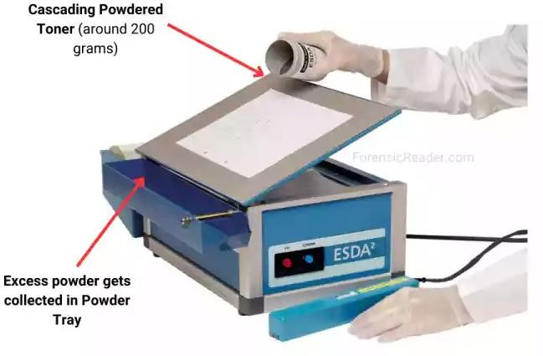
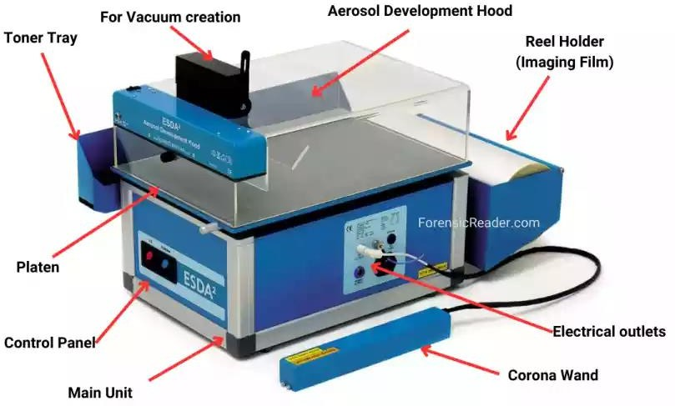
Tools and Techniques in Forensic Sciences
ESDA

Slide 27
Tools and Techniques in Forensic Sciences
1.
Questioned Documents Division:
Stereo- Zoom Microscope –
🞄 The stereoscopic microscope is an optical microscope arrangement designed for low magnification observation of a sample,
characteristically using light reflected from the surface of an object rather than transmitted through it.
🞄 The instrument uses two separate optical paths with two objectives and eyepieces to offer slightly different viewing angles to the right and left eyes.
🞄 This arrangement produces a three-dimensional visualization of the sample being examined.
🞄 Stereomicroscopy correspondences macro-photography for examining solid samples with complex surface topography and
recording, where a three-dimensional observation is required for examining the detail.
🞄 They are therefore widely used in industries for production, assessment and quality control. A stereo microscope is an important tool in entomology and forensic ballistics.
🞄 In such a microscope, both eyes observe the same image, with the two eyepieces serving to provide greater observing
comfort. However, the image in such a microscope is no different from that obtained with a single monocular eyepiece.

Slide 28
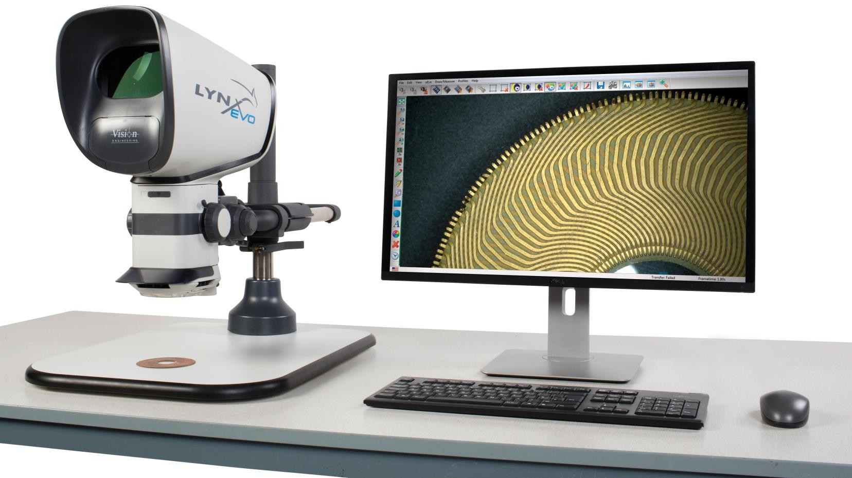
Tools and Techniques in Forensic Sciences
Stereo- Zoom Microscope

Slide 29
Tools and Techniques in Forensic Sciences
2.
Physics Division
Refractometer –
🞄 Glass, as physical evidence, is repeatedly encountered in several crimes, such as housebreaking, traffic collisions, homicides, sexual assaults, gunfire incidents, arson, and vandalism. Consequently, during investigations glass forms one of the evidentiary materials in many criminal cases.
🞄 The flakes of broken glass window panes may be lodged in the suspect’s garments or shoes during the act of burglary or crime, particles of headlight glass found at the crime scene may offer indications that may confirm the identity of a suspected vehicle.
🞄 A forensic glass examination is typically a comparison of two or more glass fragments in an attempt to determine if they originated from different sources. Less frequently, it is a question of determination of end use, or glass provenance.
🞄 Glass examinations are commonly conducted by refractive index measurements by the application of Refractometers. A refractometer is a laboratory or field device for the measurement of an index of refraction.

Slide 30
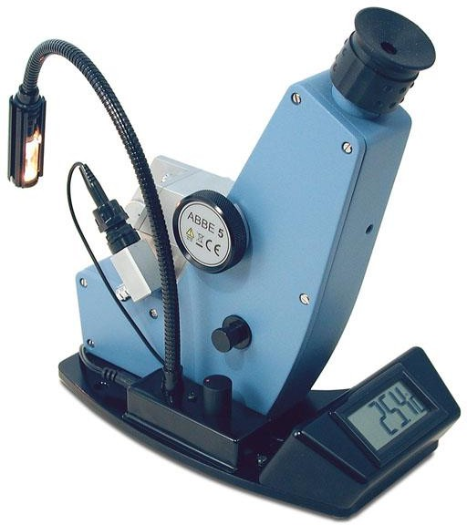
Tools and Techniques in Forensic Sciences
Refractometer

Slide 31
Tools and Techniques in Forensic Sciences
2.
Physics Division
Scanning Electron Microscope (SEM) –
🞄 A Scanning Electronic Microscope, popularly known as the SEM, is used for the observation of specimen surfaces.
🞄 When the specimen is irradiated with a fine electron beam, the secondary electrons are emitted from the specimen surface. The topography of the surface can be observed by two-dimensional scanning of the electron beam over the surface and the acquisition of an image from the detected secondary electrons.
🞄 The Scanning Electronic Microscope requires an electron Optical system to produce an electron probe, a specimen stage to place the specimen, a secondary electron detector to collect secondary electrons, an image display unit, and an operation system to perform various operations.
🞄 The electron optical system consists of an electron gun, a condenser lens and an objective lens to produce an electron probe, a scanning coil to scan the electron probe and other components.
🞄 The electron optical system present which is inside of the microscope column and the space surrounding the specimen are
kept in a vacuum.

Slide 32
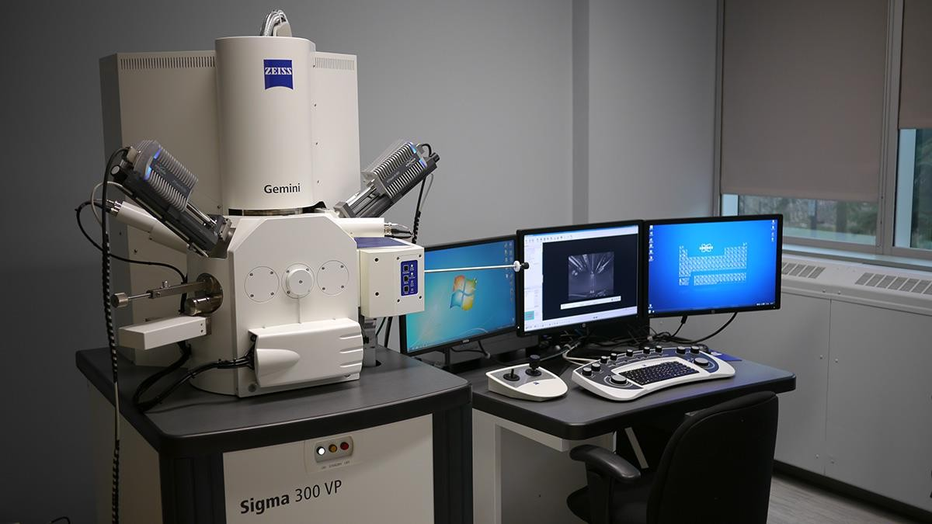
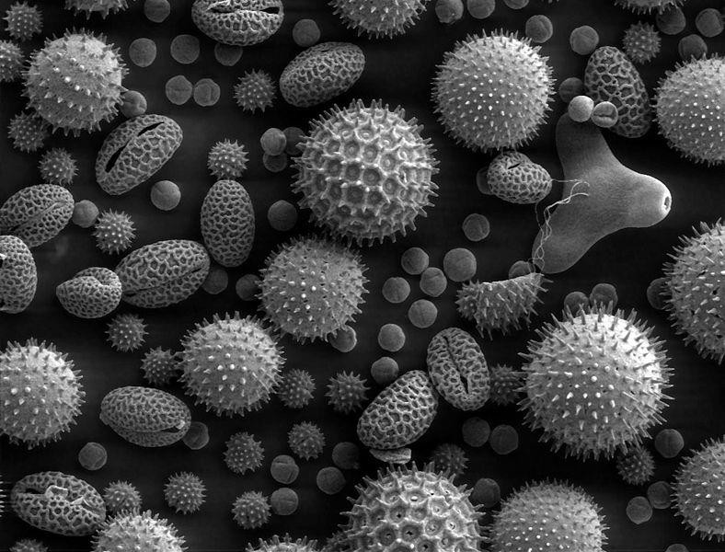
Tools and Techniques in Forensic Sciences
Scanning Electron Microscope (SEM)

Slide 33
Tools and Techniques in Forensic Sciences
2.
Physics Division
Differential Thermal Analysis (DTA) – (NOT DONE)
🞄 It consists of measuring changes in heat content as a function of the temperature difference between the sample under investigation and a thermally inert reference compound as the two materials are heated at elevated temperatures or cooled to sub-normal temperatures at predetermined rates.
🞄 In this manner enthalpy changes such as melting, vaporisation, crystallographic phase transition or chemical changes are detected from the endo and exothermic bands and peaks that appear on the thermo grams.
🞄 The corresponding weight change is determined by Thermo gravimetric analysis.
🞄 Complete thermo analytical data are obtained only by utilising both methods of analysis.
🞄 The information obtained, coupled with X-ray diffraction, Optical and chemical analysis of the residues and any involved gases provides a quantitative estimation of solid-state reactions.

Slide 34
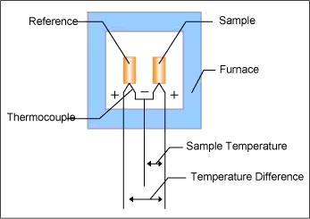
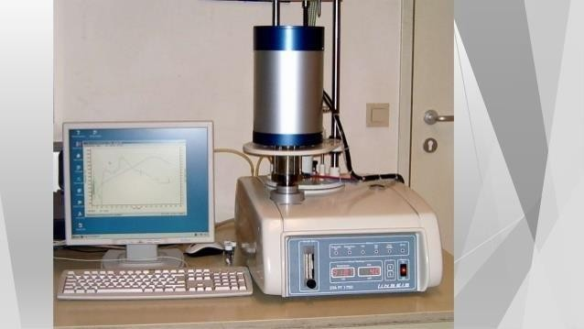
Tools and Techniques in Forensic Sciences
Differential Thermal Analysis (DTA)

Slide 35
Tools and Techniques in Forensic Sciences
2.
Physics Division
Sound Spectrograph –
🞄 A spectrograph is an instrument that separates incoming audio waves according to their wavelength and records the resulting
spectrum in some detector.
🞄 The sound spectrograph, an automatic sound wave analyzer, is used for the analysis and classification of human speech sounds and in the analysis and treatment of speech and hearing disorders.
🞄 The analogue sound spectrograph samples energy levels in a small frequency range from a magnetic tape recording and marks those energy levels on electrically sensitive paper.
🞄 This instrument then analyses the next small frequency range and samples and marks the energy levels at that point.
🞄 This process is repeated until the entire desired frequency range is analyzed for that portion of the recording.
🞄 The finished product is known as Spectrogram. It is a graphic depiction of the patterns, in the form of bars or formants, of the acoustical events during the time frame analyzed.

Slide 36
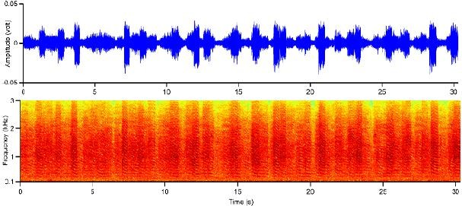
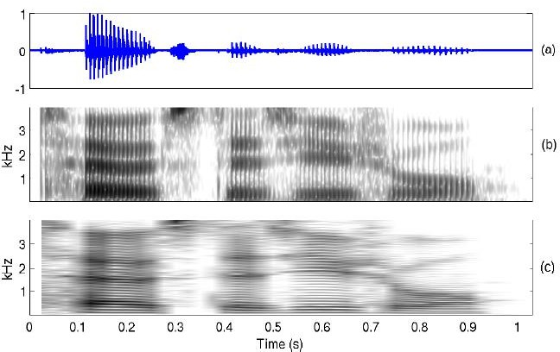
Tools and Techniques in Forensic Sciences
Sound Spectrograph

Slide 37
Tools and Techniques in Forensic Sciences
2.
Ballistics and Explosives Division
Integrated Ballistics Identification System (IBIS) –
🞄 The Integrated Ballistics Identification System (IBIS) is used to acquire, store and compare digital images from projectiles and cartridge cases.
🞄 The system is a screening tool that facilitates the laboratory in categorizing local, national, and international relationships that may exist
amongst firearms cases surrendered for inspection.
🞄 Images of projectiles and cartridge cases are digitally taken, and uploaded for comparison.
🞄 IBIS is a computer-based system that helps law enforcement agencies identify firearms and link ballistic evidence to crime scenes.
🞄 IBIS was created by Forensic Technology (FT) to help police quickly and efficiently identify firearm evidence.
Features | Description
How it works | IBIS records and compares images of bullets and cartridge casings to a database of images.
Purpose | IBIS helps police identify firearms used in crimes, and link ballistic evidence to previous investigations.
Components | IBIS has two stations: a Data Acquisition Station and an Image Analysis Station.
Uses | IBIS is used in over 80 countries.
Software | IBIS is the software behind the National Integrated Ballistics Information Network (NIBIN), which is operated by the Bureau of Alcohol, Tobacco, Firearms, and Explosives and the Federal Bureau of Investigation (FBI).

Slide 38
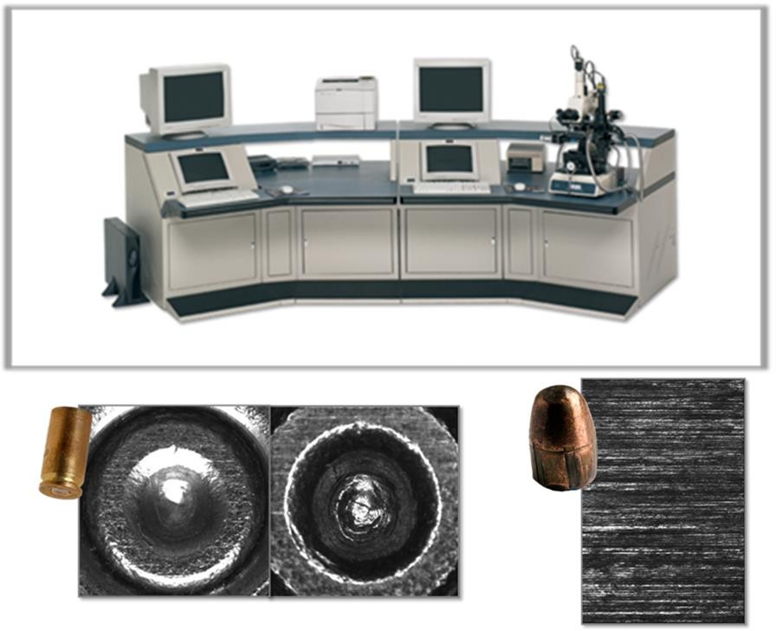
Tools and Techniques in Forensic Sciences
Integrated Ballistics Identification System (IBIS)
https://www.youtube.com/watch?v=HzTH043tHAQ

Slide 39
Tools and Techniques in Forensic Sciences
2.
Physics Division
Neutron Activation Analysis–
🞄 Neutron activation is a general term for irradiating material with neutrons to create radionuclides.
🞄 Neutron Activation Analysis was discovered in 1936 when Hevesy and Levi revealed that a sample comprising certain uncommon earth elements became extremely radioactive after exposure to a source of neutrons. From this scrutiny; they rapidly predict the probability of engaging nuclear reactions on samples trailed by the capacity of the induced radioactivity to facilitate both qualitative and quantitative identification of many elements.
🞄 It is a nuclear technique that measures the concentration of elements in a material by analyzing the gamma rays emitted after the material is exposed to neutrons.
🞄 NAA is non-destructive, accurate, and sensitive, and can analyze samples as small as a few micrograms. It can also simultaneously determine the concentration of up to 70 elements in a material.
🞄 NAA is used in many fields, including biology, agriculture, industry, food and nutrition, and forensic science (for GSR analysis).
🞄 NAA is expensive, requires a high radiation dose, and requires highly skilled investigators. There are also technical and
analytical difficulties involved in using short half-life radionuclides.

Slide 40
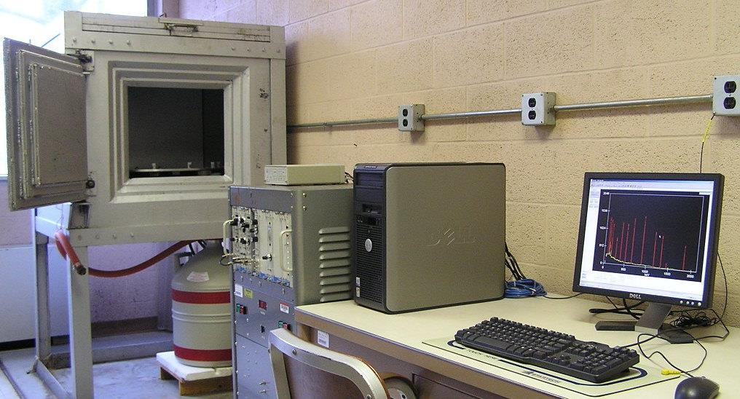
Tools and Techniques in Forensic Sciences
Neutron Activation Analysis Unit
https://www.youtube.com/watch?v=Sg2J6Dbzc4M

Slide 41
Tools and Techniques in Forensic Sciences
2.
Physics Division
Comparison Microscope –
🞄 Comparison Microscope is essentially two microscopes linked to an optical bridge that permits the observer to detect two objects concurrently with the same grade of magnification. This instrument can have a monocular or binocular eyepiece.
🞄 A comparison microscope is a crucial tool in forensic science that allows for the side-by-side comparison of two objects simultaneously. It is used to identify, compare, and determine the origin of samples such as bullets, cartridge cases, firearms, and shrapnel.
🞄 Features of a comparison microscope:
🞄 Two microscopes: A comparison microscope combines two microscopes with a shared eyepiece.
🞄 Optical bridge: The microscopes are connected by an optical bridge, which creates a split view window.
🞄 Adjustable illumination: Some comparison microscopes have two light sources that provide top and bottom illumination.
🞄 Polarizer and analyzer: Some comparison microscopes can be used to view samples under cross polarization, which enhances transparent surfaces.
🞄 Trinocular body: Some comparison microscopes have a trinocular body that allows samples to be viewed on a computer or video monitor.
🞄 The comparison microscope is a major benefit in forensics because it allows for the 3D comparison of two objects, rather than relying on
memory or a 2D picture.

Slide 42
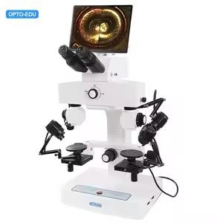
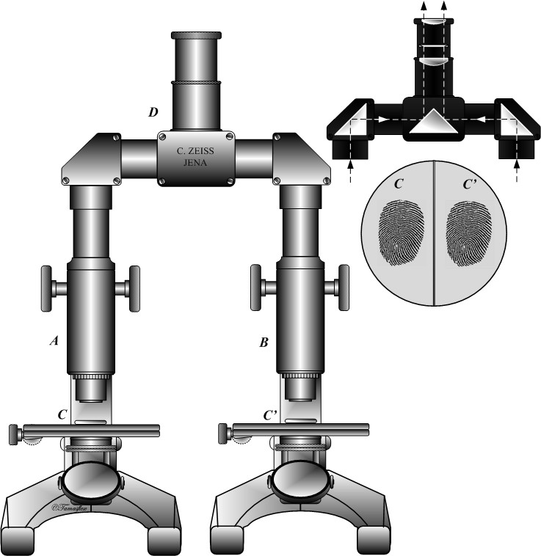
Tools and Techniques in Forensic Sciences
Comparison Microscope
https://www.youtube.com/watch?v=QXwkCCMIsZw ; https://www.youtube.com/watch?v=nlo_hFCGzWM

Slide 43
Tools and Techniques in Forensic Sciences
3.
Fingerprints Division
Automated Fingerprint Identification System (AFIS) –
🞄 AFIS is primarily used by forensic scientists for criminal identification.
🞄 The assembly of physical evidence at a crime scene will be useless if such evidence cannot be properly handled and analyzed. Since fingerprints are the most often recovered physical evidence, constructing the system of investigating such prints contributes the maximum toward greater success in identifying criminal offenders through the use of physical evidence.
🞄 Automated Fingerprint Identification System or AFIS enables computers to make rapid and accurate comparisons between
fingerprints and the vast number of fingerprints in police records.
🞄 AFIS is a biometrics system usually used in law enforcement where groups of prints improved in the crime scene were linked against the database of recognized and unidentified prints.

Slide 44
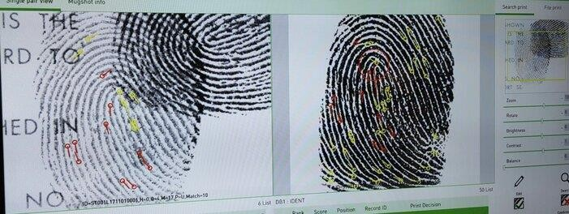
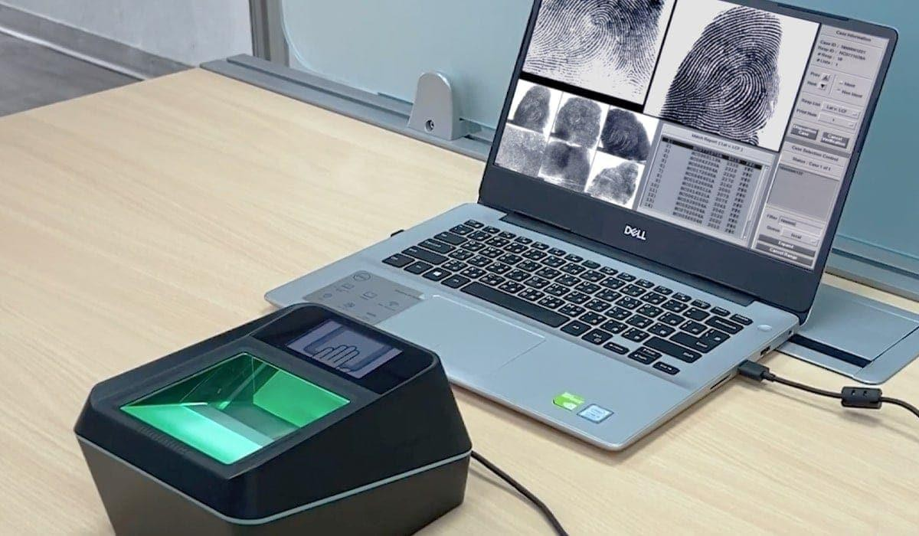
Tools and Techniques in Forensic Sciences
Automated Fingerprint Identification System (AFIS)
https://www.youtube.com/watch?v=ZKi1CKTRCQM

Slide 45
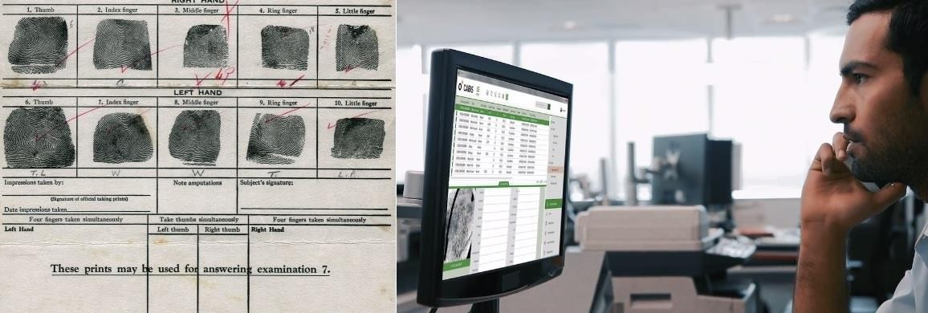
Tools and Techniques in Forensic Sciences
Automated Fingerprint Identification System (AFIS)

Slide 46
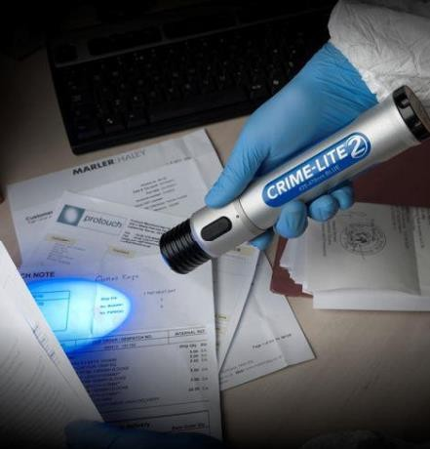
Tools and Techniques in Forensic Sciences
3.
Fingerprints Division
Poli Light –
🞄 Poli light is a portable, high-intensity light source that can be used to detect
fingerprints, bodily fluids, and other evidence at crime scenes.
🞄 It is made up of a powerful lamp containing the ultra-violet, visible and
infrared components of light.
🞄 It screens down the light into separate colour bands that improve the imagining of evidence by light interface techniques comprising fluorescence (evidence glows), absorption (evidence darkens), and oblique lighting (small particle evidence exposed).
Poli Light

Slide 47
Tools and Techniques in Forensic Sciences
3.
Biology Division
Polymerase Chain Reaction (PCR) –
🞄 Polymerase Chain Reaction (PCR) is a laboratory technique that amplifies a specific DNA segment into billions of copies.
🞄 It is used to study small DNA samples, diagnose infectious diseases, and screen for genetic abnormalities.
🞄 How it works: Uses DNA polymerase to synthesize new strands of DNA that are complementary to a template strand.
🞄 What it is used for: Amplifying DNA for gene cloning, diagnosing infectious diseases, and prenatal screening.
🞄 Who invented it: Kary Mullis, an American biochemist, invented PCR in 1983.
🞄 Key enzyme: Taq DNA polymerase, which is derived from Thermus aquaticus, is the most common enzyme used for PCR.
🞄 PCR is based on the ability of DNA polymerase to add nucleotides to a pre-existing 3’-OH group. This requires a primer to add the first nucleotide, which allows researchers to specify the region of DNA they want to amplify.

Slide 48
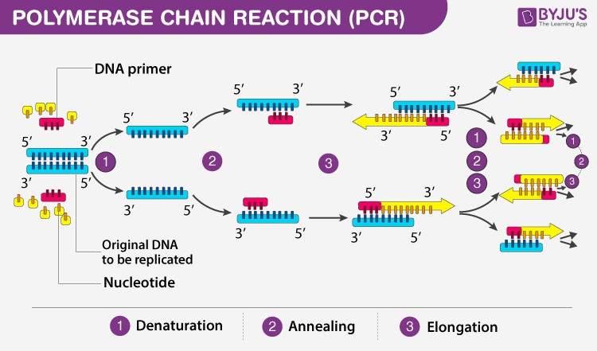
Tools and Techniques in Forensic Sciences
Polymerase Chain Reaction (PCR)
https://www.youtube.com/watch?v=ClhUe53W7xw

Slide 49
Tools and Techniques in Forensic Sciences
3.
Biology Division
Restriction Fragment Length Polymorphism Method (RFLP) –
🞄 Restriction Fragment Length Polymorphism (RFLP) is a technique that detects variations in DNA sequences by analyzing the
length of DNA fragments produced by restriction enzymes.
🞄 How it works: DNA is digested with a restriction enzyme, which cuts at specific sites in the DNA. The resulting DNA fragments are separated by size using gel electrophoresis and then compared to a known pattern.
🞄 Uses: RFLP is used in many areas, including:
Genome mapping: RFLP can be used to map genomes.
Paternity testing: RFLP can be used to determine paternity by comparing the DNA of the child and potential parents.
Hereditary disease diagnostics: RFLP can be used to diagnose hereditary diseases.
🞄 History: RFLP was invented in 1984 by Alec Jeffreys while he was researching hereditary diseases.
🞄 Advantages: RFLP can analyze large regions of DNA without prior sequence information or oligonucleotide synthesis.
🞄 Limitations: RFLP can be affected by background noise from the detector, which can cause irreproducible peaks.

Slide 50
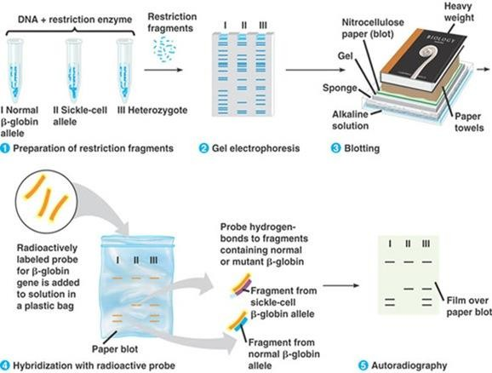
Tools and Techniques in Forensic Sciences
Restriction Fragment Length Polymorphism (RFLP)
https://www.youtube.com/watch?v=swQ_pm4cR5o

Slide 51
Tools and Techniques in Forensic Sciences
3.
Biology Division
Short Tandem Repeat Method (STR) –
🞄 STR (short tandem repeat) analysis is a DNA profiling technique that is commonly used in criminal cases and other forensic applications.
🞄 It is based on the analysis of regions of DNA that contain multiple copies of short repeating sequences of nucleotide bases. These sequences repeat a variable number of times in different individuals (VNTRs), making STR analysis an effective way to identify people.
🞄 How STR analysis works:
Nuclear DNA is extracted from cells in a sample.
The polymerase chain reaction (PCR) amplifies certain regions of the DNA.
Gel electrophoresis is used to determine how many repeats of the STR sequence exist.
🞄 Some advantages of STR analysis include:
🞄 Cost effective.
🞄 Less laborious than Southern blotting.
🞄 Can detect interruptions of the repeat expansion.
🞄 There are hundreds of STR systems mapped throughout the human genome, and several dozen have been investigated for use in human identity testing.

Slide 52
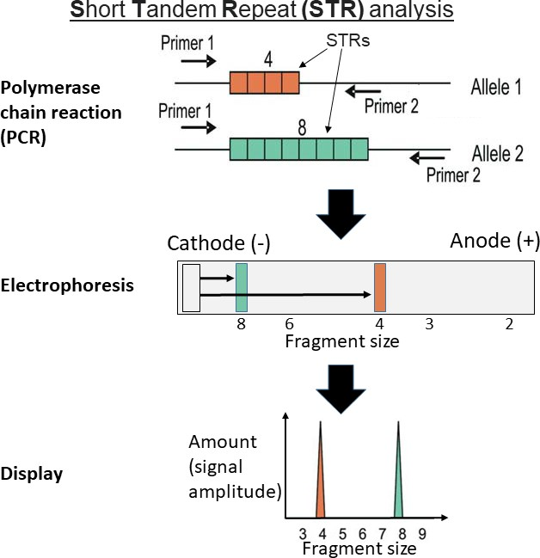
Tools and Techniques in Forensic Sciences
Short Tandem Repeat Method (STR)
https://www.youtube.com/watch?v=mVRcsw_SPT4

Slide 53
Tools and Techniques in Forensic Sciences
3.
Chemistry and Toxicology Division
Spectroscopy –
🞄 Spectroscopy is the study of the interaction of electromagnetic radiation with matter.
🞄 It is the most influential tool accessible for the study of atomic and molecular structure and is applied in the examination of
an extensive variety of tasters (people employed to test food or drink for quality by tasting it).
🞄 Spectroscopy methods are much more rapid and much less time-consuming.
🞄 They give information which is recorded in the form of a permanent chart. Generally in an automatic or semi-automatic manner.
🞄 The structural information gained by spectroscopic methods is much more precise and reliable in establishing the identity of two different compounds. They are much more selective and sensitive and extremely valuable in the analysis of highly complex mixtures and the detection of even trace amounts of impurities.
🞄 With these methods, continuous operation is often possible and this facilitates automatic control of process variables in industry.
🞄 Spectroscopy is a common procedure that can be changed in several conducts to extract the info about the energies of electronic, vibrational, rotational states, structure and symmetry of molecules and dynamic information.

Slide 54
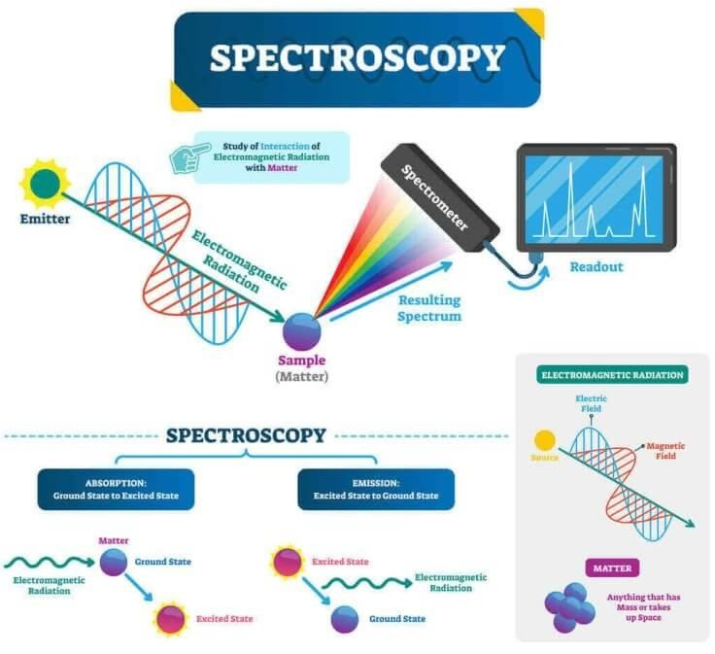
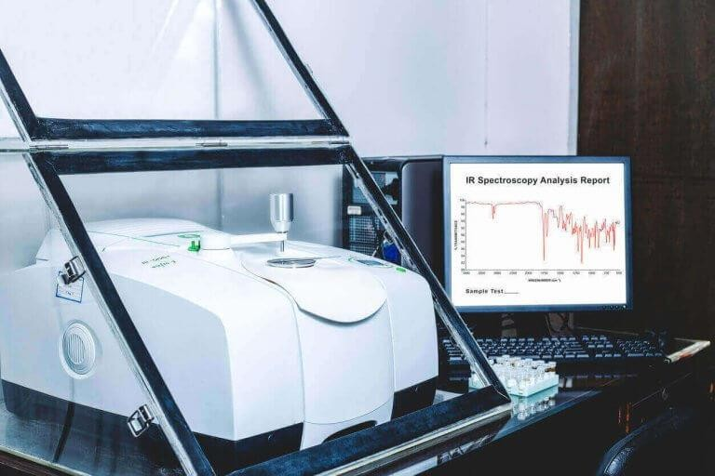
Tools and Techniques in Forensic Sciences
3.
Chemistry and Toxicology Division
Spectroscopy –
🞄 Atomic spectroscopy: This spectroscopy is concerned with the interaction of electromagnetic radiation with atoms which is commonly in their lowest energy state, called the ground state.
🞄 Molecular spectroscopy: It is the interaction of electromagnetic radiation with molecules. This results in a transition between rotational and vibrational energy levels in addition to electronic transitions.
Spectroscopy
https://www.youtube.com/watch?v=pxC6F7bK8CU

Slide 55
Tools and Techniques in Forensic Sciences
3.
Chemistry and Toxicology Division
Chromatography –
🞄 Chromatography is an important biophysical technique that enables the separation, identification, and purification of the
components of a mixture for qualitative and quantitative analysis.
🞄 It is based on the principle where molecules in a mixture are applied onto the surface or into the solid, and the fluid stationary
phase (stable phase) separates from each other while moving with the aid of a mobile phase.
🞄 The factors effective in this separation process include molecular characteristics related to adsorption (liquid-solid), partition (liquid-solid), and affinity or differences among their molecular weights. Because of these differences, some components of the mixture stay longer in the stationary phase, and they move slowly in the chromatography system, while others pass rapidly into the mobile phase, and leave the system faster.
🞄 Based on this approach three components form the basis of the chromatography technique:
🞄 Stationary phase: This phase is always composed of a “solid” phase or “a layer of a liquid adsorbed on the surface a solid support”.
🞄 Mobile phase: This phase is always composed of “liquid” or a “gaseous component.”
🞄 Separated molecules

Slide 56
Tools and Techniques in Forensic Sciences
3.
Chemistry and Toxicology Division
Chromatography –
🞄 The type of interaction between the stationary phase, mobile phase, and substances contained in the mixture is the basic component effective in the separation of molecules from each other.
🞄 Chromatography methods based on partition are very effective in the separation, and identification of small molecules such as amino
acids, carbohydrates, and fatty acids.
🞄 However, affinity chromatography (i.e. ion-exchange chromatography) is more effective in the separation of macromolecules such as nucleic acids and proteins.
🞄 Paper chromatography is used in the separation of proteins, and studies related to protein synthesis.
🞄 Gas-liquid chromatography is utilized in the separation of alcohol, ester, lipid, and amino groups, and observation of enzymatic interactions.
🞄 Molecular-sieve chromatography is employed especially for the determination of molecular weights of proteins.
🞄 Agarose-gel chromatography is used for the purification of RNA, DNA particles, and viruses.
🞄 Stationary phase in chromatography, is a solid phase or a liquid phase coated on the surface of a solid phase.
🞄 The mobile phase flowing over the stationary phase is gaseous or liquid.
🞄 If the mobile phase is liquid it is termed as liquid chromatography (LC), and if it is gas then it is called gas chromatography (GC).
🞄 Gas chromatography is applied for gases, mixtures of volatile liquids, and solid materials, whereas Liquid chromatography is used especially for thermal unstable, and non-volatile samples.

Slide 57
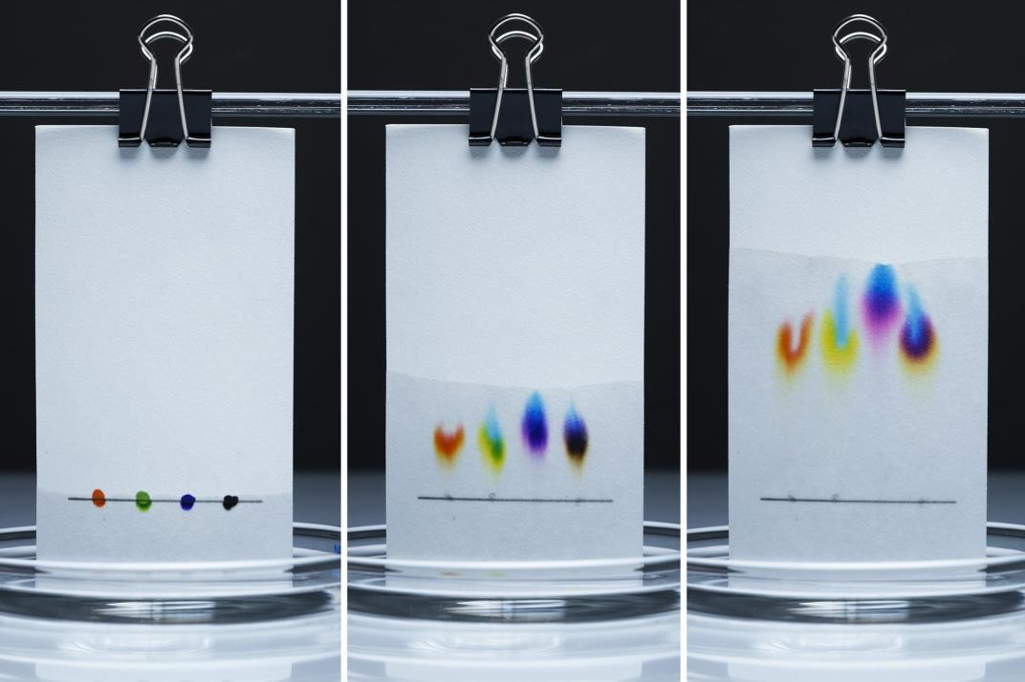
Tools and Techniques in Forensic Sciences
3.
Chemistry and Toxicology Division
Chromatography –
🞄 The purpose of applying chromatography which is used as a method of quantitative analysis apart from its separation, is to achieve a
satisfactory separation within a suitable time interval.
🞄 Various chromatography methods have been developed to that end. Some of them include column chromatography, thin-layer chromatography (TLC), paper chromatography, gas chromatography, ion exchange chromatography, gel permeation chromatography, high- pressure liquid chromatography, and affinity chromatography [6].
🞄 Types of chromatography:
🞄 Column chromatography
🞄 Ion-exchange chromatography
🞄 Gel-permeation (molecular sieve) chromatography
🞄 Affinity chromatography
🞄 Paper chromatography
🞄 Thin-layer chromatography
🞄 Gas chromatography
🞄 Dye-ligand chromatography
🞄 Hydrophobic interaction chromatography
🞄 Pseudoaffinity chromatography
🞄 High-pressure liquid chromatography (HPLC)

Slide 58
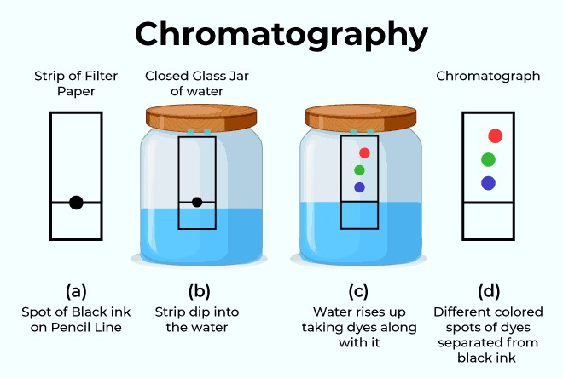
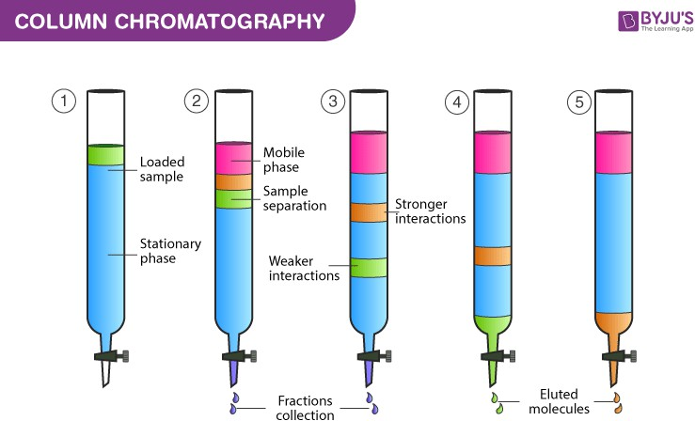
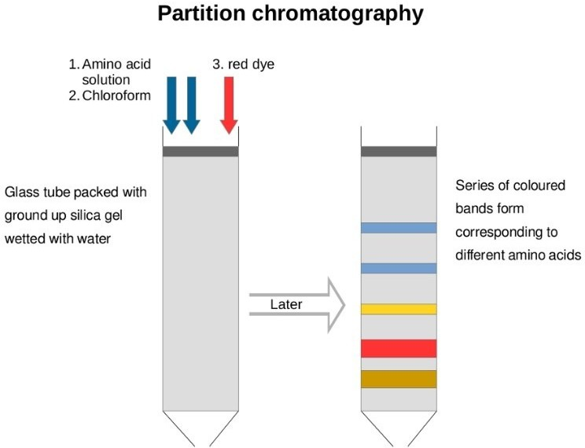
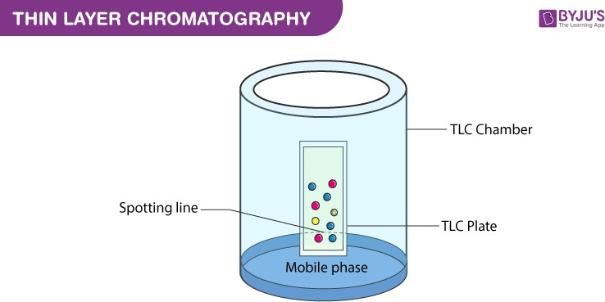
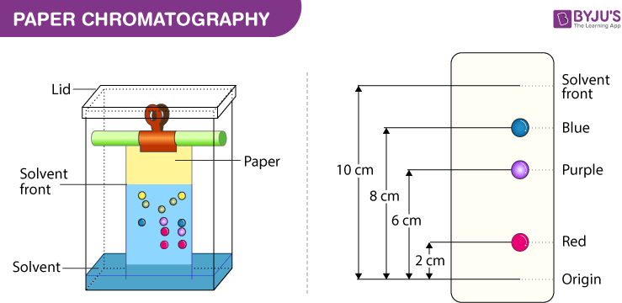
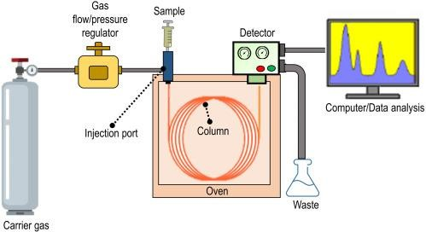
Tools and Techniques in Forensic Sciences
https://www.youtube.com/watch?v=TdJ57SQ6GAQ &ab_channel=Cognito
Types of Chromatography

Slide 59
Tools and Techniques in Forensic Sciences
3.
Chemistry and Toxicology Division
Narcotics Identification Kit –
🞄 The global drug problem continues to increase, with the production and trafficking of drugs and narcotics, and impacting communities worldwide.
🞄 The NIK field ostensible test kits are part of a tranquillizer, a drug identification system that is considered to speedily classify materials being prohibited or controlled materials.
🞄 The NIK System of Narcotics Identification is the only global customary for field testing apprehensive substances. Using advanced chemistry, the system presumptively identifies the most commonly encountered narcotic and street drugs.
🞄 The NIK Polytesting System is the most widely used and successful presumptive drug testing system available in the market
today.
🞄 Law enforcement officers are expected to combine their investigative skills and experience, knowledge of the characteristics of suspected narcotics, and the expected colour reactions from the field tests to appropriately classify assumed narcotics.
🞄 The NIK system is designed to presumptively identify compounds based on probabilities and the use of multiple tests in
succession. The more tests used in the identification of a substance, the greater the probability of positive indication.

Slide 60
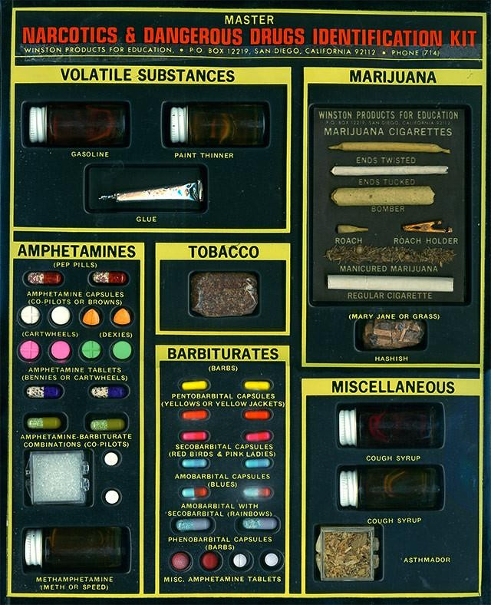
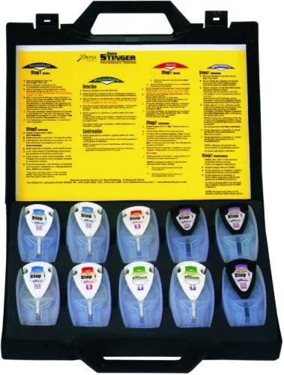
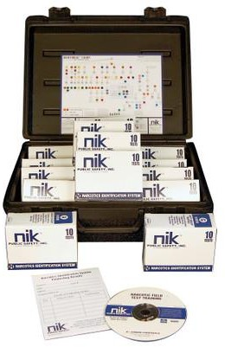
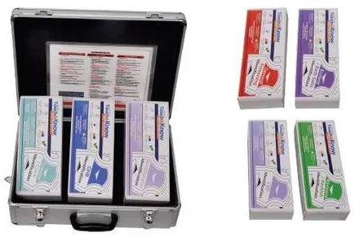
Tools and Techniques in Forensic Sciences
Narcotics Identification Kit
https://www.youtube.com/watch?v=YqbB9eqqKjw&ab_channel=DetectaChem

Slide 61
Tools and Techniques in Forensic Sciences
3.
Other Divisions
Polygraph –
🞄 The polygraph is the ancient and paramount recognized lie indicator technology. The polygraph is a set of equipment that accurately measures and registers numerous functional directories like blood pressure, pulse, respiration and skin conductivity while the subject is asked and answers a series of questions.
🞄 The belief is that deceptive answers will produce physiological responses that can be distinguished from those related to non- deceptive responses. In recent years brain movement has also been instigated to be measured on this site.
🞄 The polygraph is widely used by analytical staff in a variety of medical and scientific settings for purposes other than lie detection. In lie detection circumstances its usage is grounded on the evidence that dishonesty is escorted by variations in the action signified by the polygraph.
🞄 A polygraph is occasionally known as a lie detector, which is a misnomer. A polygraph does not sense lies, but only stimulation which is expected to accompany telling a lie.
🞄 Polygraph inspectors have no other choice than to measure dishonesty secondarily, as a configuration of physiological movement directly associated with deceitful does not exist.
🞄 Three of the four most widespread lie recognition processes by the polygraph are built upon the premise that, while answering ‘relevant’ questions, liars will be further stimulated than during responding to ‘control’ queries, due to a fear of discovery. Since the development of polygraphs, it has been widely applied in criminal investigations.

Slide 62
Tools and Techniques in Forensic Sciences
3.
Other Divisions
Brain Mapping –
🞄 The brain-mapping test is done to interpret the behaviour of the suspect and corroborates the investigating officers’ observation and the suspect’s statements.
🞄 It is a test that maps the brain to reveal ‘guilty knowledge’.
🞄 It measures the changes in the electrical field potentials produced by the sum of the neuronal activity in the brain using electrodes placed on the surface of the skin covering the head and face. The changes directly related to specific perceptual or cognitive events are called event-related potentials.
🞄 In simple words, it is based on the finding that the brain generates a unique brain-wave pattern when a person encounters a
familiar stimulus.
🞄 Commonly used method in India is called as Brain Electrical Oscillation Signature Profiling, also known as the ‘P300 Waves test’. During the tests, forensic experts apply unique technologies to find out if a suspect’s brain recognizes things from the crime scene that an innocent suspect would have no knowledge of.
🞄 Concisely, experts say the brain fingerprinting test as the brain-mapping test, since both tests matches information stored in
the brain with information from the crime scene.
🞄 Studies have shown that an innocent suspect’s brain would not have stored or recorded certain information, which an actual perpetrator’s brain would have stored.

Slide 63
Tools and Techniques in Forensic Sciences
3.
Other Divisions
Narco Analysis –
🞄 Narco-Analysis test is also known as “Truth Serum Test”.
🞄 Drugs sometimes are used clinically. Some of them are Seconal, Hyoscine (scopolamine), Sodium Pentothal, Sodium Amytal and Phenobarbital. These drugs produce a state of semi-consciousness in the subject and the reasoning faculty of the individual becomes ineffective.
🞄 These drugs works on the principle of inhibiting the thought filtration procedure of the brain.
🞄 Now a days, the importance of Narco-Analysis test is increasing with the time. It has great importance at the time of Crime investigation. In fact it has become an integral part of the crime investigation.

Slide 64
A law enforcement agency is any agency, which enforces the law. This may be a special, local, or state police, federal agencies such as the Federal Bureau of Investigation (FBI) or the Drug Enforcement Administration (DEA). In addition, it can be used to describe an international organisation such as Europol or Interpol.
Forensic Science in International Perspectives: Various Agencies Involves In Criminal Investigations
The following are the agencies involved in criminal investigations:
INTERPOL
The International Criminal Police Organization, commonly known as Interpol, facilitates worldwide police cooperation and crime control. Its headquarters is in Lyon, France, and it is the world’s largest international police organization, with seven regional bureaus worldwide and a National Central Bureau in all 195 member states. Interpol was conceived during the first International Criminal Police Congress in 1914, which brought officials from 24 countries to discuss cooperation in law enforcement. It was founded in September 1923 as the International Criminal Police Commission (ICPC), adopting many of its current duties throughout the 1930s. After coming under Nazi control in 1938, the agency was effectively declining until the end of World War II. In 1956, the ICPC adopted a new constitution and the name Interpol, derived from its telegraphic address used since 1946.
It provides investigative support, expertise, and training to law enforcement worldwide, focusing on three major areas of transnational crime: terrorism, cybercrime, and organized crime. Its broad directive covers virtually every kind of crime, including crimes against humanity, child pornography, drug trafficking and production, political corruption, intellectual property infringement, and white-collar crime. The agency also facilitates cooperation among national law enforcement institutions through criminal databases and communications networks. Contrary to popular belief, Interpol is not a law enforcement agency.

Slide 65
FBI (Federal Bureau of Investigation) -
The FBI is an intelligence-driven and threat-focused national security organization with both
intelligence and law enforcement responsibilities. It is the principal investigative arm of the
U.S. Department of Justice and a full member of the U.S. Intelligence Community. The FBI has the authority and responsibility to investigate specific crimes assigned to it and to provide other law enforcement agencies with cooperative services, such as fingerprint identification, laboratory examinations, and training. The FBI also gathers, shares, and analyzes intelligence, both to support its own investigations and those of its partners and to better understand and combat the security threats facing the United States.
FBI is the main investigative agency of the United States federal government. It is a part of the Department of Justice and is responsible for enforcing federal laws and investigating criminal activity.
The FBI’s work includes:
Forensic Science in International Perspectives: Various Agencies Involves In Criminal Investigations
Investigating crimes: The FBI investigates a variety of crimes, including terrorism,
cybercrime, white collar crimes, public corruption, and civil rights violations.
Gathering intelligence: The FBI collects, shares, and analyzes intelligence to support its own investigations and to help other law enforcement agencies.
Providing services to other law enforcement agencies: The FBI offers services such as
fingerprint identification, laboratory examinations, and training to other law enforcement agencies.
International operations: The FBI has a significant international presence, with Legal Attache offices in U.S. embassies and consulates around the world. The FBI also offers international training opportunities for law enforcement leaders from around the world.
The FBI was established in 1908 as the Bureau of Investigation. The FBI is not a national police force, and state and local governments are primarily responsible for law enforcement in the United States.

Slide 66
III. NATIONAL INVESTIGATION AGENCY (NIA)
The National Investigation Agency (NIA) is India’s apex counter-terrorist task force.
It deals with the investigation of terror-related crimes across states without special permission from the states under a written proclamation from the Ministry of Home Affairs. The Agency came into existence with the enactment of the National Investigation Agency Act 2008 by the Parliament of India on 31 December 2008, which was passed after the deadly 26/11 terror attack in Mumbai. Such an attack revealed the failure of intelligence and the ability to track such activities by existing agencies in India. Hence the Government of India realized the need for a specific body to deal with terror-related activities in India, thereby establishing the NIA.
Its Headquarter is situated in New Delhi, the NIA has branches in Hyderabad, Guwahati, Kochi, Lucknow, Mumbai, Kolkata, Raipur, Jammu, Chandigarh, Ranchi, Chennai and Imphal.
It maintains the NIA Most Wanted list.
The founding Director-General of NIA was Radha Vinod Raju, and he served until 31 January 2010. Current DG - Kuldeep Singh in June 2021.
Forensic Science in International Perspectives: Various Agencies Involves In Criminal Investigations
CENTRAL BUREAU OF INVESTIGATION (CBI)
The Central Bureau of Investigation (CBI) is the premier investigating agency of India which is operating under the jurisdiction of the Ministry of Personnel, Public Grievances and Pensions, Government of India.
Initially, it was set up to investigate bribery and governmental corruption. Later on in 1965, it received expanded jurisdiction to investigate breaches of central laws enforceable by the Government of India, multi-state organised crime, multi-agency or international cases.
The agency has been known to investigate several economic crimes, special crimes, cases of
corruption and other cases. CBI is exempted from the provisions of the Right to Information Act.
CBI is India's officially designated single point of contact for its relationship with Interpol. The CBI headquarters is located in New Delhi.

Slide 67
ENFORCEMENT DIRECTORATE (ED)
The Directorate of Enforcement (ED) is a law enforcement agency and economic intelligence agency
responsible for enforcing economic laws and fighting economic crime in India.
It is part of the Department of Revenue, Ministry of Finance, Government Of India.
It is composed of officers from the Indian Revenue Service, Indian Police Service and the Indian Administrative Service as well as promoted officers from its cadre. The prime objective of the Enforcement Directorate is the enforcement of two key Acts of the Government of India namely, the Foreign Exchange Management Act 1999 (FEMA) and the Prevention of Money Laundering Act 2002 (PMLA)
Sanjay Kumar Mishra former Chief Commissioner of Income Tax, New Delhi was appointed as ED chief in the rank of Secretary to the Government of India
Forensic Science in International Perspectives: Various Agencies Involves In Criminal Investigations
NARCOTICS CONTROL BUREAU (NCB)
The Narcotics Control Bureau is an Indian central law enforcement and intelligence agency under the Ministry of Home Affairs, Government of India.
The agency is tasked with combating drug trafficking and the use of illegal substances under the
provisions of Narcotic Drugs and Psychotropic Substances Act.
The Narcotics Control Bureau was created on 17 March 1986 to enable the full implementation of The Narcotic Drugs and Psychotropic Substances Act, 1985 and fight its violation through the Prevention of Illicit Trafficking in Narcotic Drugs and Psychotropic Substances Act, 1988.
The chief purpose of the Narcotics Control Bureau is to fight drug trafficking on an all-India level.
It works in close cooperation with the Customs and Central Excise/GST, State Police Department, Central Bureau of Investigation (CBI), Central Economic Intelligence Bureau (CEIB) and other Indian intelligence and law enforcement agencies both at the national and states level.
The NCB also provides resources and training to the personnel of India’s Drug Law Enforcement Agencies in fighting drug trafficking. The NCB also monitors India's frontiers to track down points where smuggling activities take place with foreign traffickers.
Current D.G: Satya Narayan Pradhan

Slide 68
1. Collecting evidence: Forensic scientists collect evidence from crime scenes and
Duties of Forensic Scientist
Forensic scientists perform a variety of duties, including:
accidents, such as trace evidence, body fluids, hair, glass, paint, and drugs.
Analyzing evidence: Forensic scientists perform chemical, biological, and microscopic analyses on evidence. They may also use techniques like DNA profiling, mass spectrometry, and chromatography.
Consulting with experts: Forensic scientists may consult with experts in specialized
fields, such as toxicology and odontology.
Preparing reports: Forensic scientists prepare technical reports, including statistical analyses of forensic evidence.
Testifying in court: Forensic scientists provide the results of their examinations as proof in court. They may testify to defend the victim or to support the case against the culprit.
Researching and developing new technologies: Forensic scientists may research and develop new technologies for evidence handling and processing.
Operating laboratory equipment: Forensic scientists operate, maintain, and clean laboratory facilities and equipment.
🞄 Forensic scientists need to have good communication skills, critical thinking skills, and be detail-oriented. They also need to be able to stay professional and composed, as crime scenes and evidence can be gruesome.

Slide 69
1. Objectivity and Impartiality: Forensic scientists must remain neutral and objective, conducting analyses without bias or influence from external parties, including law enforcement, attorneys, or victims. Conclusions should be based solely on scientific evidence and methods.
The Code of Conduct for Forensic Scientists is a set of ethical and professional guidelines that ensure the integrity, objectivity, and reliability of forensic practices. These principles are crucial for maintaining trust in the legal and criminal justice systems. Key elements of the code include:
Code of Conduct for Forensic Scientists
2. Confidentiality: All case-related information must be kept confidential, and only disclosed to authorized parties involved in the case. Forensic scientists must respect the privacy and sensitivity of the information they handle.
3. Scientific Integrity: Ensure the use of validated methods, techniques, and equipment, and follow established scientific standards. Maintain accuracy in reporting findings, clearly stating the limitations of the methods used. Continuous improvement through professional development and staying current with advancements in forensic science is encouraged.
4. Accuracy in Reporting: Reports should be clear, concise, and detailed, including all relevant findings, methods used, and any
potential limitations or uncertainties. Findings should not be exaggerated or understated to influence the outcome of a case.
5. Avoidance of Conflicts of Interest: Forensic scientists must avoid situations where personal, financial, or other relationships could compromise or appear to compromise their objectivity.
6. Accountability and Responsibility: Forensic scientists must take full responsibility for their work, ensuring that it meets the highest professional standards. If mistakes are identified in analysis or reporting, they should be corrected promptly.
7. Professional Competence: Forensic scientists must work within their areas of expertise, refusing assignments that fall outside
their qualifications. They must remain aware of their limitations and seek guidance when necessary.
8. Testimony and Communication: When called to testify in court, forensic scientists must present their findings truthfully, avoiding misrepresentation or overstating the strength of their conclusions. They should communicate their findings in a manner that is understandable to non-experts (judges, juries, etc.).
9. Adherence to Legal Standards: Forensic scientists must be aware of and adhere to the legal standards and rules of the jurisdiction in which they operate. By adhering to these principles, forensic scientists help ensure that their work is reliable and that it contributes to the fair administration of justice.

Slide 70
1. Educational Requirements:
The qualifications of a forensic scientist typically involve a combination of education, skills, and professional development in the field of forensic science. Below are the key qualifications required for a forensic scientist:
Qualifications of Forensic Scientist
🞄 Bachelor’s Degree: A minimum of a bachelor’s degree in forensic science, chemistry, biology, or a related field is typically required. Degrees in disciplines like toxicology, molecular biology, or criminal justice with a forensic science focus are also relevant.
🞄 Advanced Degree: While not always mandatory, a master’s or doctoral degree in forensic science or a specialized area (such as DNA analysis, toxicology, or forensic chemistry) can be highly beneficial for career advancement or specific roles.
🞄 Specialized Training: Postgraduate training or certification in specific forensic techniques (such as fingerprint analysis, ballistics, or forensic anthropology) is often required, depending on the area of specialization.
Scientific Knowledge:
🞄 Strong Foundation in Science: Forensic scientists must have in-depth knowledge of the natural sciences (chemistry, biology, physics) and understand how scientific principles apply to the analysis of evidence.
🞄 Proficiency in Laboratory Techniques: They should be skilled in using laboratory equipment and following scientific procedures for evidence collection, preservation, and analysis.
Technical and Analytical Skills:
🞄 Attention to Detail: Forensic scientists need to have strong observational skills and attention to detail to accurately analyze evidence and avoid mistakes in their conclusions.

Slide 71
Technical and Analytical Skills:
🞄 Attention to Detail: Forensic scientists need to have strong observational skills and attention to detail to accurately analyze evidence and avoid mistakes in their conclusions.
🞄 Analytical Thinking: The ability to apply critical thinking and problem-solving skills to interpret complex data and produce clear, objective results.
🞄 Computer Proficiency: Familiarity with forensic software, data analysis programs, and laboratory management systems is important, especially for digital forensics and DNA profiling.
Communication Skills:
🞄 Report Writing: Forensic scientists must be able to write clear, detailed, and objective reports that explain their methods, findings, and conclusions.
🞄 Courtroom Testimony: Many forensic scientists are required to present their findings as expert witnesses in court. This requires the ability to explain complex scientific concepts in a manner that can be understood by non-experts, such as judges and juries.
Ethical and Professional Standards:
🞄 Objectivity: Forensic scientists must remain impartial and objective in their analysis and avoid bias or external influence from law enforcement or legal teams.
🞄 Confidentiality: They must maintain strict confidentiality of sensitive case information,
ensuring that all evidence and findings are handled responsibly.
Qualifications of Forensic Scientist

Slide 72
6. Certifications and Continuing Education:
Qualifications of Forensic Scientist
🞄 Certifications: Many forensic scientists pursue professional certifications to enhance their qualifications. Certifications can come from professional bodies like the American Board of Criminalistics (ABC), the International Association for Identification (IAI), or the American Board of Forensic Toxicology (ABFT).
🞄 Continuing Education: Since forensic science constantly evolves with new techniques and technologies, ongoing education and professional development through workshops, seminars

Slide 73
Data depiction in forensic science is the process of visually representing complex scientific data and evidence findings to make them comprehensible for investigators, legal professionals, and courts. Effective depiction of forensic data is crucial for communicating results accurately and clearly.
Key Methods of Data Depiction:
🞄 Charts and Graphs: Used to represent statistical data, patterns, or trends (e.g., DNA matching percentages, toxicology levels, or blood spatter analysis). Bar charts, histograms, and pie charts are common for summarizing evidence comparisons.
🞄 Photographs: High-resolution images of crime scenes, fingerprints, ballistic markings, or injuries are
vital for visual evidence. Photographs help depict the context and detail of the physical evidence.
🞄 Diagrams and Sketches: Crime scene diagrams, reconstructive drawings, and forensic reconstructions (such as facial reconstruction) are used to depict spatial relationships and positions of objects or people.
🞄 3D Models and Simulations: Advanced forensic software creates 3D models of crime scenes or objects (e.g., bullet trajectory, accident reconstruction). These interactive models can be used in court to explain complex scenarios.
🞄 Tables and Matrices: Tabular formats summarize quantitative data (such as toxicology reports, chemical compositions, or DNA sequences), offering clear comparison points across various samples or evidence types.
🞄 Digital Forensics Visualization: In cases involving digital forensics, data from computers or mobile devices (e.g., IP addresses, message logs, timelines) is often depicted through network maps, digital timelines, or flowcharts.
Clear and precise data depiction enhances the understanding of forensic evidence and contributes to its accurate interpretation and presentation in the justice system.
Data Depiction in Forensic Science

Slide 74
Report Writing (General)
🞄 A forensic report, unlike a clinical report, is written for the benefit of the court and is typically about the subject rather than for the subject. As the primary work product of forensic evaluations, forensic reports usually influence the court's decision. Because of their importance, they require more care than an average report.
🞄 Importance of Forensic Reports:
🞄 A Forensic report plays a very important role in the justification of criminal cases in the courtroom.
🞄 The results of forensic-related investigations are often detailed in a forensic report.
🞄 These reports are often used for several purposes, including billing, affidavits, and as proof of what was found or not found.
🞄 These reports are very important to a case since the improper processing of the data or missing key evidence can mean the
difference between winning and losing a case.
🞄 Reports are legal documents: The forensic report offers evidence to a court of law. As such, it must be accurate to the best of the examiner’s ability. This includes not only clinical features of the report but also the simplest of identifying information. for example, a defendant’s date of birth. The report should have a professional appearance. The reports are property of the court, and should generally not be released by the examiner to any party, including attorneys and defendants. Upon court order, facilities or court clinics may release the reports.
🞄 Length of Reports: No particular page length is suggested but the following guidelines are offered:
🞄 Very short reports often do not include enough clinical data and explanations so be as helpful to the Court as they should be.
🞄 Very long reports, on the other hand, may become onerous for the Court.
🞄 It is important to examine all reports carefully to ensure that they do not contain irrelevant data, redundancies, or more extensive discussion than is needed to address the clinical/legal issues with ease, clearly and adequately.

Slide 75
Report Writing (General)
While creating a forensic report:
🞄 Provide accurate information on the examinee’s identity and dates of evaluation.
🞄 Describe how the examinee was informed of the purpose of the evaluation and the limits of confidentiality.
🞄 List all sources of data for the evaluation.
🞄 Clearly state the legal standard that defines the forensic purpose of the evaluation, ncluding the specific questions the examiner was asked to address.
Organization and Style:
🞄 Organize the report in a manner that is logical and assists the reader’s understanding.
🞄 Report only data, not inferences, in one database section of the report.
🞄 Report inferences and opinions in another section, which uses the earlier data but offers no new data.
🞄 Use language that minimizes the potential for bias or the appearance of gratuitous evaluative judgments.
🞄 Use language that will be understood by non-clinicians and non-legal personnels, taking care to simplify complex concepts and
professional technical terms.
🞄 Avoiding typographical errors and incomplete sentences.

Slide 76
Report Writing (General)
Interpretations and Opinions:
🞄 Address only the forensic questions that were asked in the referral process.
🞄 Provide a clear explanation for every important opinion or conclusion that you offer.
🞄 Summarizing the relevant data and how they logically support the opinion.
🞄 Identify alternative interpretations that might be considered, and explain how the data were used to weigh these interpretations against the opinion you are offering.
🞄 Produce interpretations and opinions that are logical and internally consistent.
🞄 When opinions or recommendations require specialized knowledge (e.g., medical conditions or their treatment), express opinions only on matters for which you are qualified and competent.
The standard headings are:
🞄 Identifying Information
🞄 Legal Criteria for Determining Competence to Stand Trial
🞄 Sources of Information
🞄 Relevant History: A brief description of any significant points regarding:
🞄 the defendant’s history of family socialization and personality development.
🞄 History of social adaptations to (e.g.) school, work, peer relationships, marriage
🞄 History of past mental difficulties, treatment (especially hospitalizations) and response to treatment
🞄 History of substance abuse
🞄 History of criminal justice involvements including, when available, history of incarcerations with associated difficulties
🞄 History of violence toward others and/or self
🞄 Significant medical history
🞄 Circumstances of Referral

Slide 77
Report Writing (General)
Report Format
Title Page:
🞄 Title: Descriptive title of the report (e.g., "Fingerprint Analysis Report").
🞄 Case Number/Identifier: Unique identification number for the case.
🞄 Date: Date of the report’s completion.
🞄 Name of Examiner: Name, qualifications, and designation of the forensic scientist or examiner.
🞄 Lab/Agency Information: Name and address of the forensic laboratory or agency.
Table of Contents (if applicable): Used for lengthy reports with multiple sections, especially in cases involving multiple analyses.
Introduction/Background:
🞄 Case Information: Brief overview of the case, including how and why the evidence was submitted.
🞄 Objective: State the purpose of the analysis (e.g., to determine if fingerprints match a suspect).
🞄 Evidence Description: Outline the type of evidence received (e.g., blood sample, weapon, digital evidence).
🞄 Chain of Custody: Mention how the evidence was handled and transferred, if relevant.

Slide 78
Report Writing (General)
IV. Materials and Methods:
🞄 Materials: List of materials and equipment used for the analysis.
🞄 Methods: Detailed description of the procedures and techniques used to examine the evidence (e.g., DNA extraction, fingerprint development methods, digital forensic tools).
🞄 Standards/Protocols: Reference to any standard operating procedures, scientific methods, or protocols followed.
IV. Examination and Analysis:
🞄 Observations: Detailed observations made during the examination of the evidence.
🞄 Tests Conducted: Outline each test or analytical method applied, and describe the results obtained from each step (e.g., chemical analysis, DNA profiling, ballistics testing).
🞄 Instruments Used: Mention any specific forensic instruments or software used for the analysis (e.g., gas chromatography, AFIS for
fingerprint matching).
IV. Results:
🞄 Objective Presentation: Provide the raw data or findings from the analysis (e.g., DNA match percentage, fingerprint ridge patterns, toxicology results).
🞄 Tables/Charts/Diagrams: Use visual aids (tables, graphs, or diagrams) where applicable to help illustrate key findings.
🞄 Photographic Evidence: Attach any photographs of evidence, microscopic images, or diagrams of patterns (e.g., crime scene photos, fingerprints).

Slide 79
Report Writing (General)
Guidelines:
🞄 In a forensic report, the referral question is often very specific.
🞄 The report should address the referral question completely, without addressing any additional issues.
🞄 The numeric data presented should be explained in a way that one who is not aware of the test can understand it well.
🞄 Opinions should not be offered if they are outside the evaluator’s area of competence.
🞄 This means that reports will likely need to be written so that the layperson can understand the material presented.
🞄 Technical language should be limited.
🞄 Headings can be particularly useful in differentiating data and making the report more reader-friendly such as the introduction, the gathered history, behavioural observations, and/or mental status. All the information gathered might be grouped into categories such as intelligence, problem-solving skills, mental health functioning, etc. This structure allows for the integration of the data in a manner that can be clinically, if not necessarily legally, relevant.
🞄 There are three generally acceptable report lengths, depending on the request of the referring party.
🞄 Short reports are approximately three pages long. These reports are essentially the conclusion section of a report, without the preceding data, along
with recommendations.
🞄 Standard report is typically somewhere between 2 and 10 pages, depending on the depth of testing conducted. This type of report would include a background history, test results, and conclusions the third, and least used, type of report is.
🞄 Comprehensive report, which can be upwards of 30 pages. This type of report should typically not be used unless the referring party specifically requests it. For instance, some sex offense-specific reports and some custody evaluations tend to be quite lengthy to include numerous legal questions that must be answered by the evaluator.

Slide 80
Report Writing (General)
Don’ts of a Forensic Report:
🞄 Don’t use overly technical language.
🞄 Don’t use lengthy, flowery language and long sentences.
🞄 Don’t overwhelm the reader with needless information.
🞄 Don’t rely on only one source of data.
🞄 Don’t use a test that will not be understandable to the court.
🞄 Don't use a test that is not valid and reliable.
Do’s of a Forensic Report:
🞄 Do avoid grammatical errors, lack of clarity, and poor writing style.
🞄 Do write reports so they can be easily understood by all audiences.
🞄 Do determine what structure report is best for the particular case. Regardless of which is used, do answer the referral question.
🞄 Do consider length; ask the referring party for guidance.
🞄 Do conclude the most important part of the report. Although it may be shorter than the data presentation section, it should be the most time-consuming to write.
🞄 Do include all data relevant to the referral question.
🞄 Do choose a test that is relevant and necessary to answer the psycho-legal question.
🞄 Do use a test that is valid given the subject’s age, race, language, and general ability level.
🞄 Do report scores in the report, including validity, normative data, and percentiles,

Slide 81
Report Writing (Digital Forensic Case)
A forensic report is a crucial document that summarizes the findings and analysis of a digital forensic investigation. It can be used as evidence in court, as a reference for further action, or as a source of learning and improvement. However, writing a forensic report is not a simple task. It requires careful planning, organization, clarity, accuracy, and ethics. In this article, you will learn about the key components of a successful forensic report and how to write them effectively.
Purpose and Scope: The first component of a forensic report is the purpose and scope. This section explains why the report was written, what the objectives and questions of the investigation were, and what the scope and limitations of the analysis were. The purpose and scope should be concise, specific, and relevant to the case. It should also define the terms and acronyms used in the report and provide a brief overview of the methodology and tools used.
Evidence and Analysis: The second component of a forensic report is the evidence and analysis. This section presents the facts and findings of the investigation, supported by relevant data and screenshots. The evidence and analysis should be organized logically, chronologically, or thematically, depending on the case. It should also explain how the data was collected, preserved, examined, and verified, using standard forensic procedures and techniques. The evidence and analysis should be objective, factual, and clear, avoiding speculation, opinion, or jargon.
Conclusions and Recommendations: The third component of a forensic report is the conclusions and recommendations. This section summarizes the main outcomes and implications of the investigation, answering the questions posed in the purpose and scope. The conclusions and recommendations should be based on the evidence and analysis, not on personal views or assumptions. They should also be concise, coherent, and consistent with the report's objectives and scope. The conclusions and recommendations should provide actionable suggestions or guidance for the client, the court, or the organization.

Slide 82
Report Writing (Digital Forensic Case)
Appendices and References: The fourth component of a forensic report is the appendices and references. This section provides additional information or details that support or supplement the main body of the report, such as raw data, code blocks, graphs, tables, or diagrams. The appendices and references should be labelled, numbered, and cited properly, using a consistent format and style. They should also be relevant, accurate, and complete, avoiding unnecessary or redundant information.
Executive Summary: The fifth component of a forensic report is the executive summary. This section provides a brief overview of the report's purpose, scope, evidence, analysis, conclusions, and recommendations, highlighting the key points and findings. The executive summary should be written last after the main body of the report is completed. It should also be written for a non-technical audience, using simple and clear language. The executive summary should be concise, informative, and persuasive, capturing the reader's attention and interest.
Format and Style: The sixth component of a forensic report is the format and style. This section refers to the appearance and presentation of the report, such as the layout, font, colour, spacing, headings, numbering, and pagination. The format and style should be consistent, professional, and easy to read, following the guidelines and standards of the client, the court, or the organization. The format and style should also be checked for spelling, grammar, punctuation, and accuracy, ensuring that the report is free of errors and typos.

Slide 83


